Slide 1


Data Structures
#LifeKoKaroLift

Slide 2



Module Name - Stacks & Queues
Class - Day 5
Topic Name: Queues
EditEdit MasterMaster texttext stylesstyles

Slide 3
Time Allocation Summary
Element | Slide numbers | Maximum time(min)
Spot Test | 4
Today’s Agenda | 5
Introduction to Queues | 6 - 11
Ticket Building System Using Queues | 12 - 13
Implementation of Queue | 14 - 15
Total Time |  | 120

Slide 4
Spot Test
Let’s take a quick revision assessment of previously taught topics :-
Operations of Stacks
Implementation of Stacks
Applications of Stacks

Slide 5

Today’s Agenda
Introduction to Queues
Ticket Building System using Queue
Implementation of Queue

Slide 6
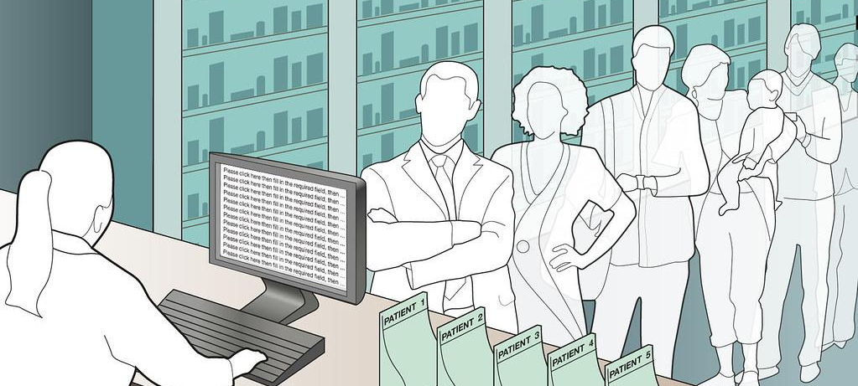
Introduction to Queues
Well that was all about LIFO order, we all know that most lines( or QUEUES) follow the FIFO order. Don’t they?
When was the last time you had to stand in a queue?
There’s a high probability it was resolved on the First In First Out basis. Because that is the defining property of a queue.

Slide 7
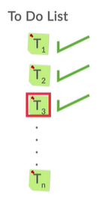
Introduction to Queues
Before we start with the technical details, try to imagine the application of queues in real life.
They are practically almost everywhere from queues at a bus stop, to a queue outside the ATM and sometimes there are even queues outside the elevators.
One such example of queues is a normal To-Do List whose tasks are resolved on the First In First Out basis. Let’s write a simple java code to implement this To-Do list:

Slide 8
Introduction to Queues
Let’s run the following code and see the output we obtain:
public class ToDoList {
public static void main(String[] args) {
MyQueue<String> todolist = new MyQueue<String>();
makeToDoList(todolist);
doAllTasks(todolist); }
public static void makeToDoList(MyQueue<String> todolist) {
todolist.add("task 1");
todolist.add("task 2");
todolist.add("task 3");
todolist.add("task 4"); }
public static void doAllTasks(MyQueue<String> todolist) {
while (todolist.size() != 0) {
System.out.println(todolist.remove()); }}}

Slide 9
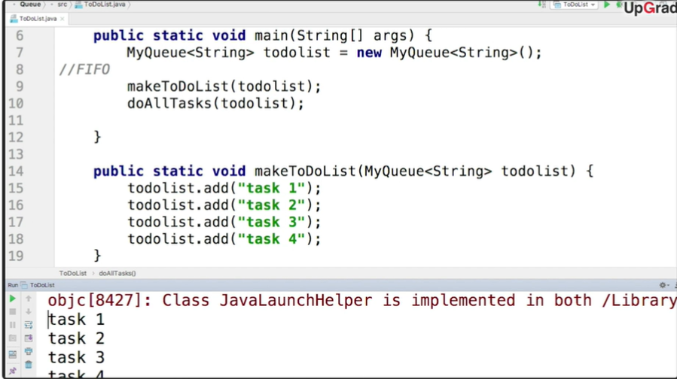
Introduction to Queues
And just as we expected, the output is all the tasks being printed in the FIFO order.

Slide 10
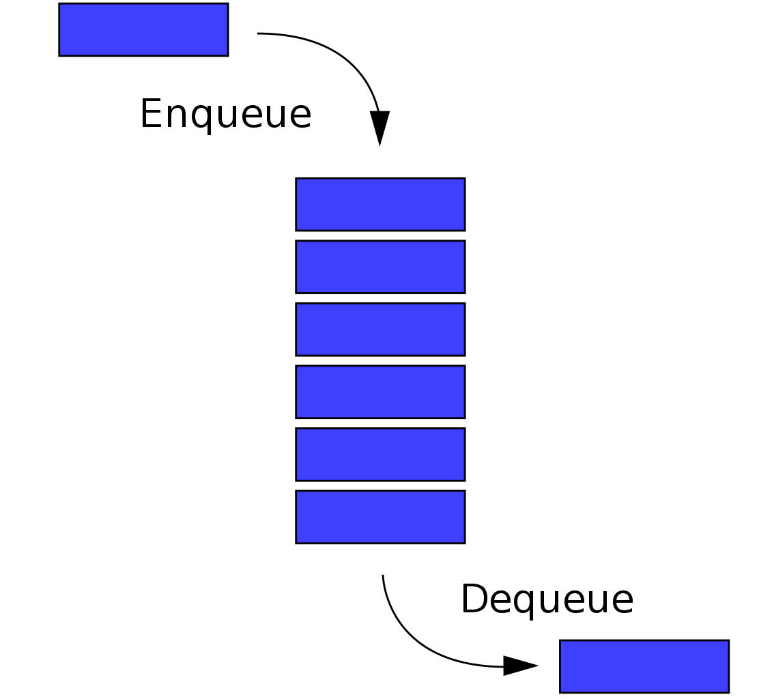
Introduction to Queues
Therefore, a queue is a data structure which follows the First In First Out order.
There are two primary operations for queues:
The insertion operation similar to Push in stack is called Enqueue. The elements are added at the top/head of the queue.
The deletion of element is performed by Dequeue operation. This deletion of elements happens at the bottom/tail of the queue.

Slide 11
Introduction to Queues
In Java, you can use an inbuilt Queue implemented using a Linked List.
Here, the convention changes a bit - Java queues don't have enqueue and dequeue methods, these operations are carried out using the following methods:
(ENQUEUE) add(x): Throws an exception if it fails to insert the object, i.e. when the queue is full
(DEQUEUE) remove(): Throws an exception if the queue is empty
peek(): Returns null if the queue is empty
isEmpty(): Returns true if the queue is empty

Slide 12

Ticket Booking System Using Queues
Well, let’s now see one of the practical applications of queue.
Ticket booking systems heavily use queues for their processes.
When an individual would make a booking request, it would be stored in queues, so that the customer who makes the request first, gets tickets first.

Slide 13
Ticket Booking System Using Queues
Another, important feature in the system is that a request could be accepted only if there are sufficient tickets in the system.
So, if a customer is making a request for 4 tickets, but there are only three tickets in the system, this request would have to be denied.
Thus, each time a request is made, the tickets available are checked. If the tickets are available, then the request is dequeued and the next request in the queue is processed.

Slide 14

Implementation of Queue
Unlike Stack, which is a class in Java, Queue is an interface that often needs to be implemented as a linked list.
Remember that you learnt about interfaces in polymorphism. They are classes that contain only abstract methods and cannot be instantiated.
In Java the Queue interface needs to be implemented by a class (usually the LinkedList class) before you can instantiate and use it.
ID: 570834163

Slide 15
Implementation of Queue
Here’s the code for the linked list implementation:
private LinkedList<T> list = new LinkedList<T>();
public void add(T el) {
this.list.add(el); }
public T remove() {
return this.list.remove(); }
public int size() {
return this.list.size(); }

Slide 16
Thank You!
#LifeKoKaroLift

